Slide 1
Improving the Resolution and Readability of Two Dimensional Medical Images Through Mathematical Transformations
Author: David Kamenov
Mentor 1:
Assoc. Prof. Stanislav Harizanov
Institute of Mathematics and Informatics,
Bulgarian Academy of Science
Mentor 2:
Alexander Kolarski
Senior Programmer

Slide 2
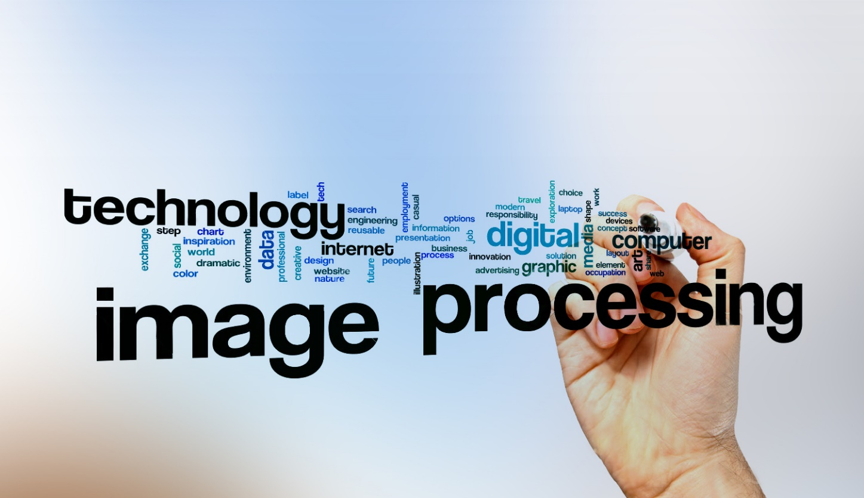
Abstract
Image Processing Usage:
Bioinformatics
Medicine
Engineering
GPS and Satellites
Archaeology

Slide 3

Introduction
Purpose:
Improving the resolution of digital Images
Improving the readability of digital Images
Decreasing the level of radiation in X-ray and tomographic images
IT CAN SAVE HUMAN LIVES BY IMPROVING IMAGING DIAGNOSTICS
IT COULD BE USED AGAINST COVID-19

Slide 4
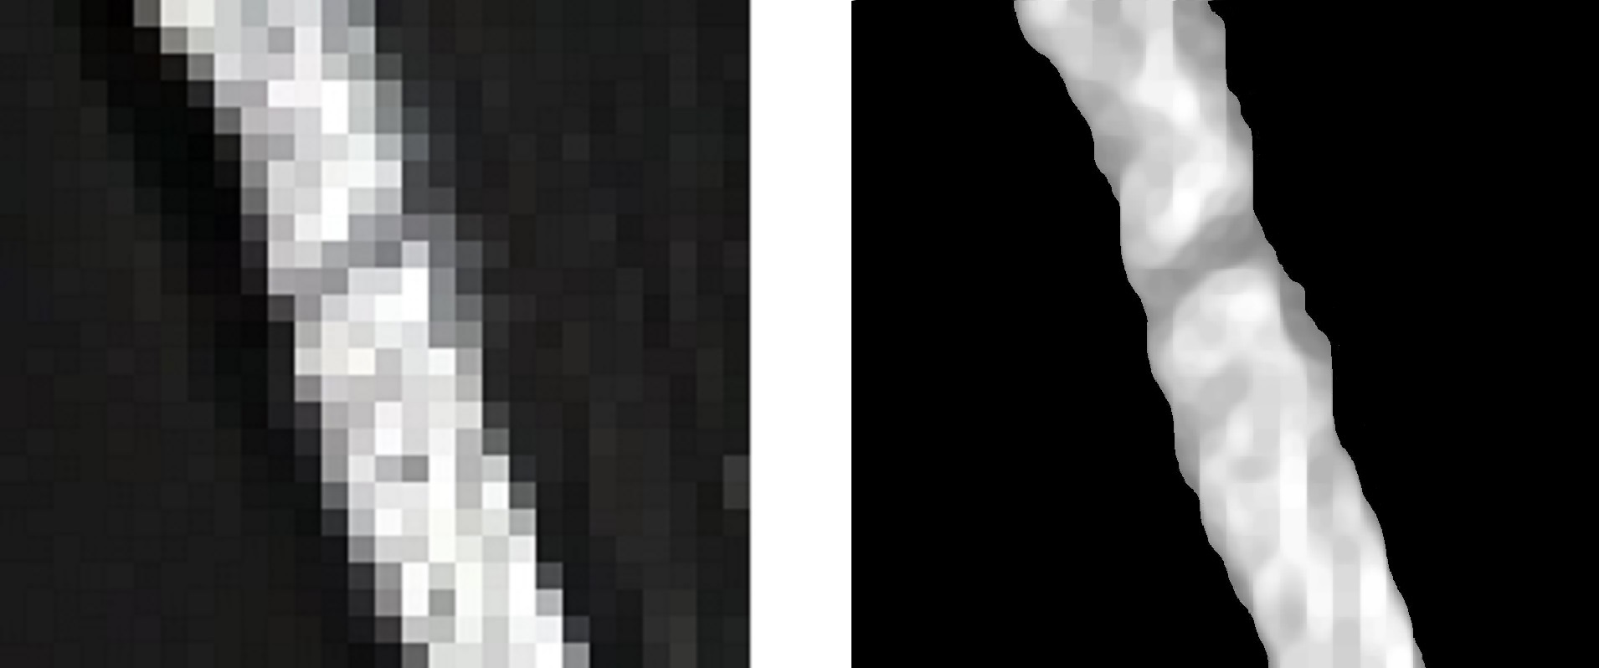
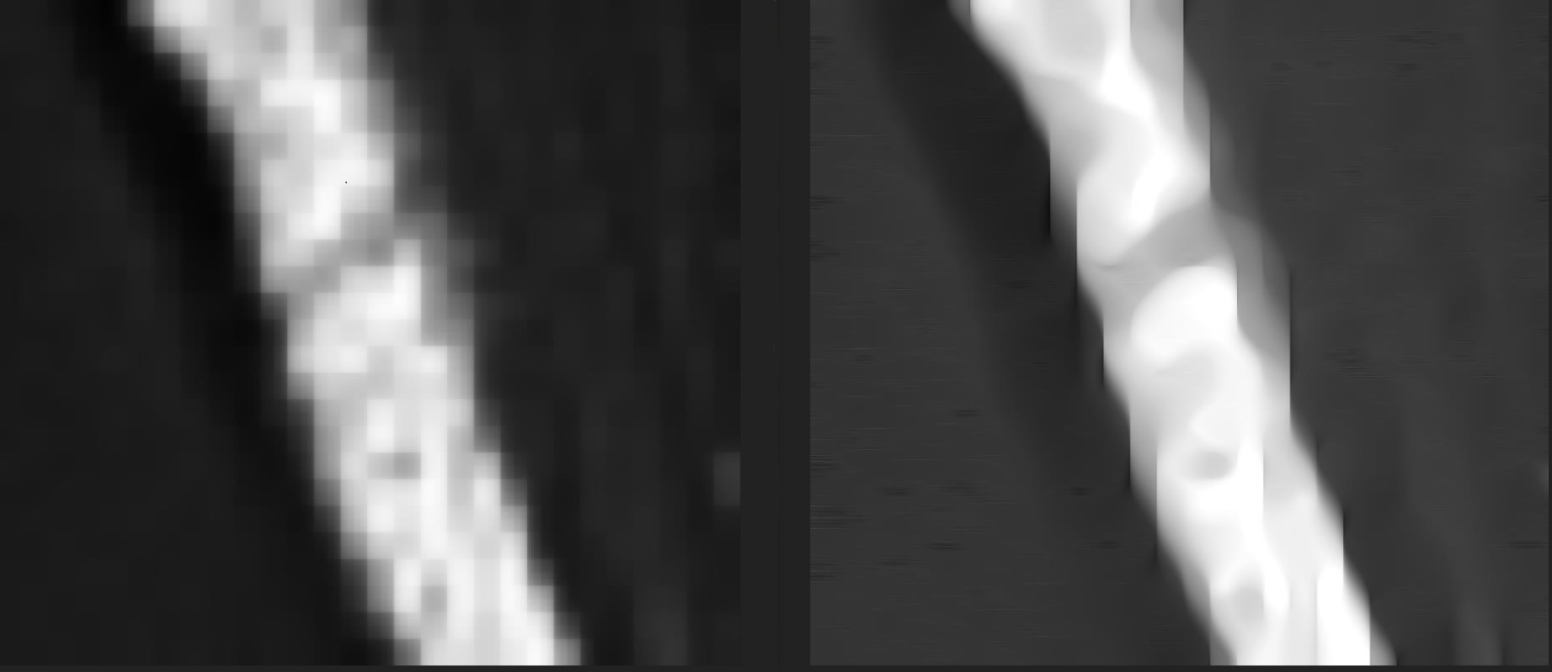

Slide 5
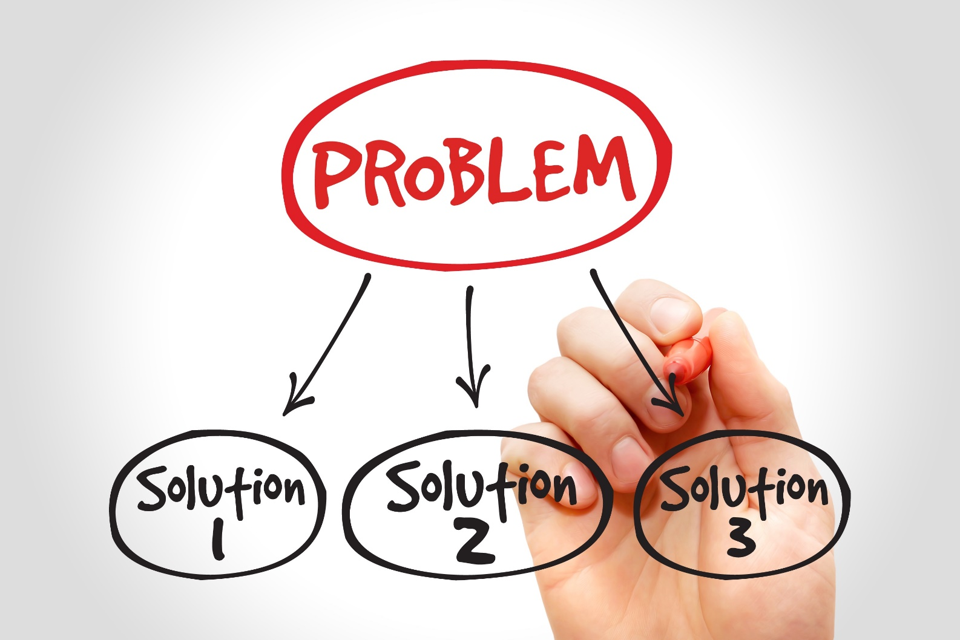
Algorithm Description
Image to Greyscale
Greyscale to Matrix
Extracting Variables Algorithm
Upsampling Algorithm
Downsampling Algorithm
Improving Image Readability Algorithm
Edge Preservation Algorithm
Matrix to Output Image

Slide 6
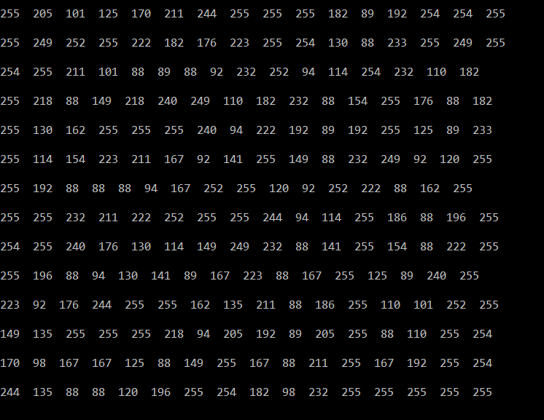

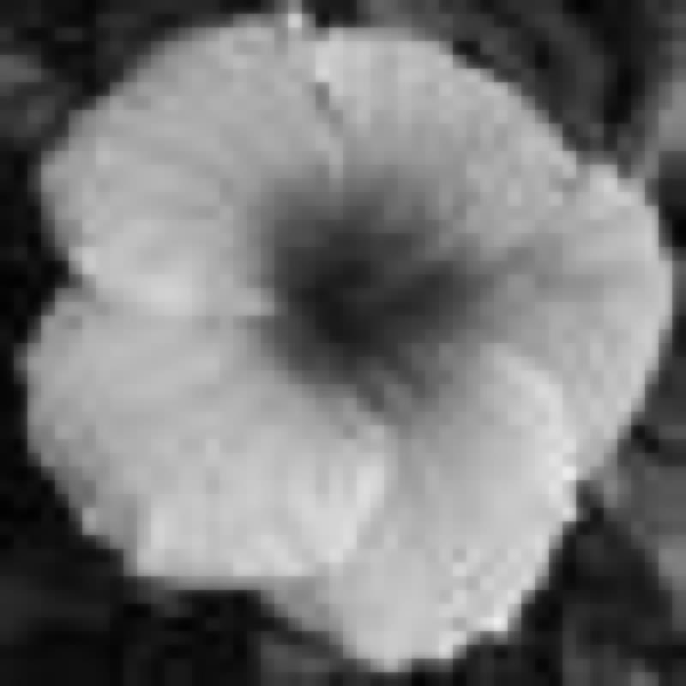
Step 1 & 2: Image to greyscale/matrix
Why? Because it is faster, more reliable and most of the medical images are greyscale
8 bit Greyscale
Greyscale to Matrix

Slide 7
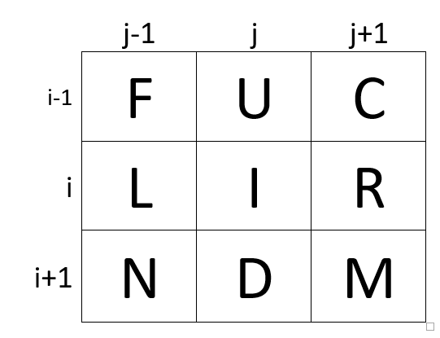
Step 3:Extracting Variables
Numerations
How to extract their values:
If the variables exist: element[i, j]
If the variables are out of bounds
Corners
Edges
This algorithm is custom made

Slide 8
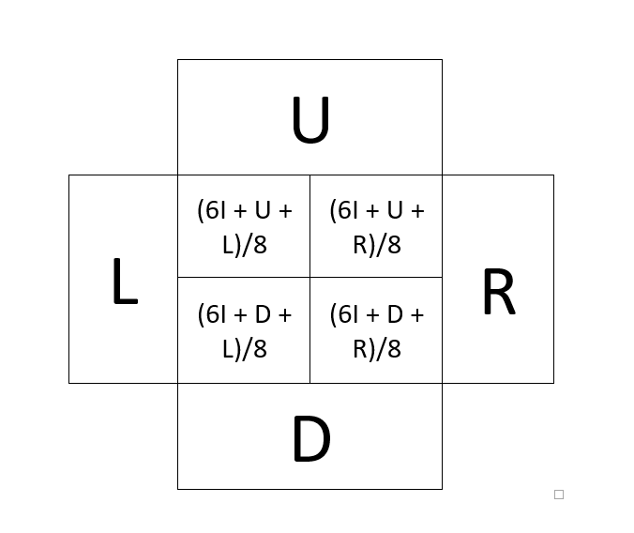

Step 4: Upsampling Algorithm
Using “Chaikin” approach
Weighted average
Formula of increasing the resolution is where “n” is the coefficient of increasing
This algorithm is custom made

Slide 9
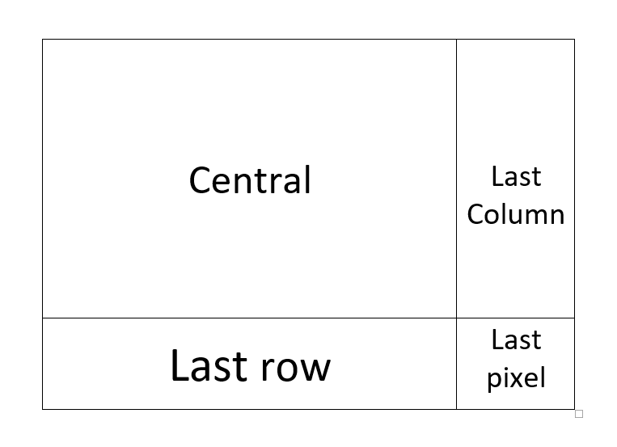
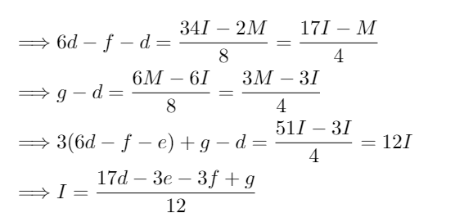
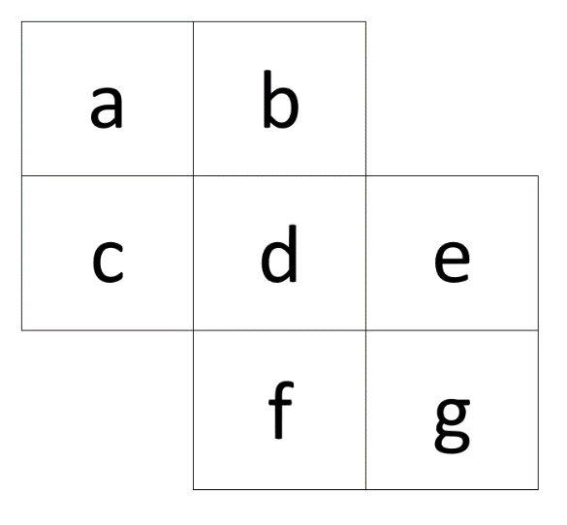
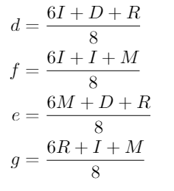
Step 5: Downsampling Algorithm
Why do we need “Downsampling algorithm”? For improving the readability.
Why the algorithm is divided to four segments? Because otherwise it goes “out of bounds”.
What is the formula and how is it created? From the upsampling algorithm.
This algorithm is custom made

Slide 10
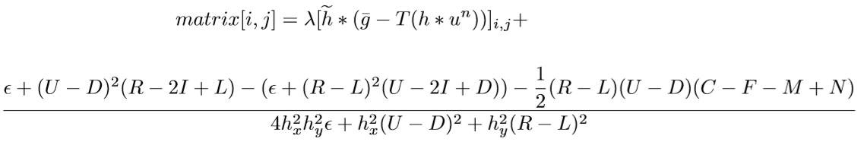
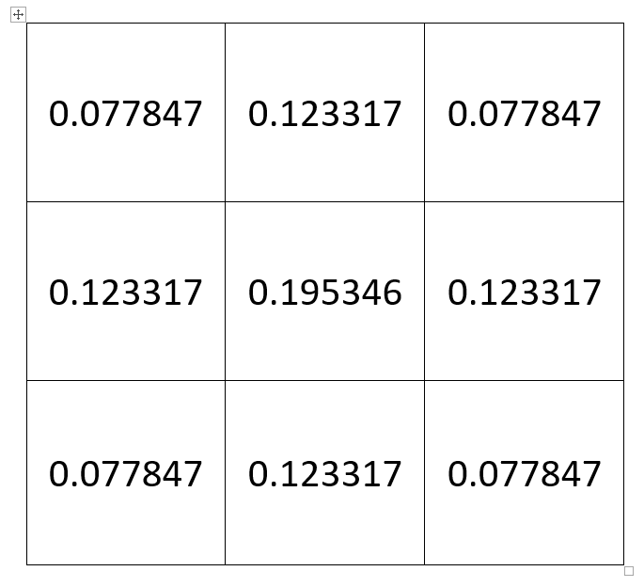
Step 6: Improving Image Readability Algorithm
This algorithm is 50% based on a science article but it was changed and a new mathematical model was created for it
S. Joshi, A. Marquina, S. Osher, I. Dinov, J. Van Horn, A. Toga. Edge-enhanced image reconstruction using (TV) total variation and Bregman reﬁnement.
LNCS Volume 5567, pp. 389–400, Springer, Berlin, Heidelberg, 2009.

Slide 11
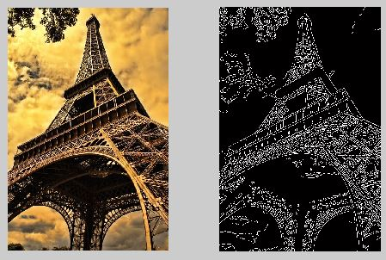
Step 7: Edge Preservation
It increases the resolution without blurring the edges
Makes the edges sharper
It preserves details
This algorithm is custom made

Slide 12
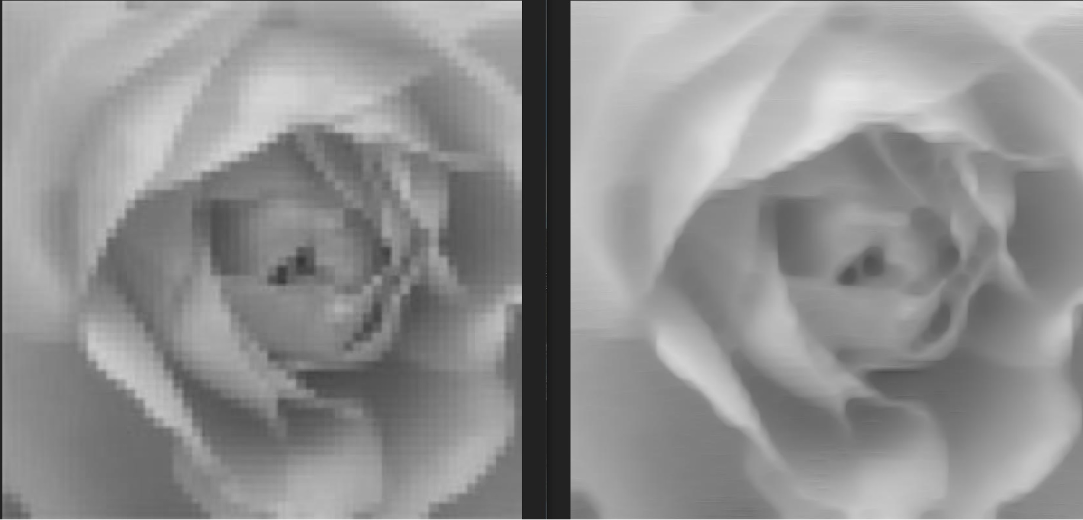

Slide 13
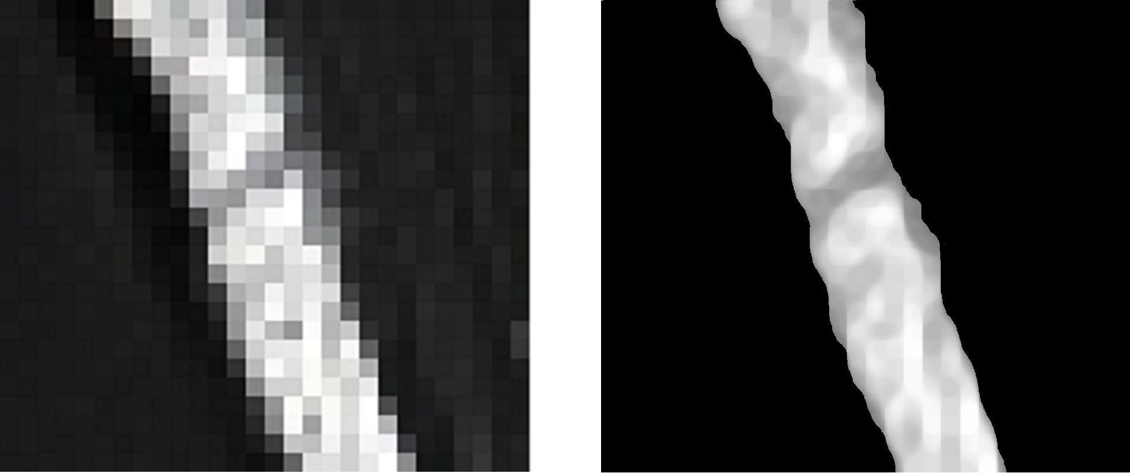
Results
Input Image
28 x 25 px.
Improving Image Resolution and Readability
1792 x 1600 px.

Slide 14
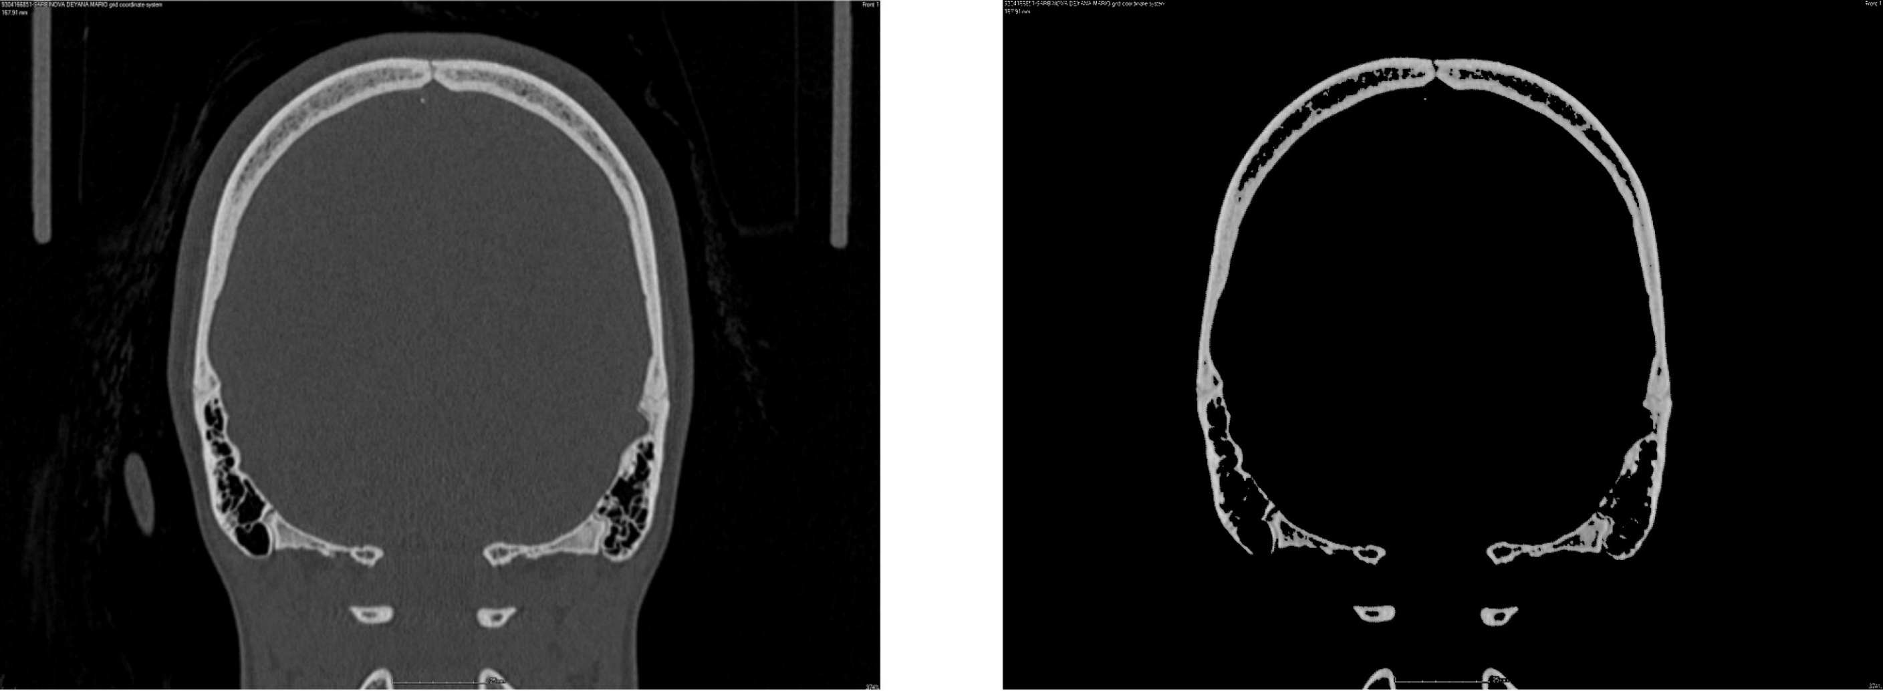
Results
Input Image
869 x 683 px.
Improving Image Resolution and Readability
13904 x 10928 px.

Slide 15


Results
Low Resolution Low Quality 16x16 px.
Improving Image Resolution
1024 x 1024 px.
Improving Image Resolution and Readability
1024 x 1024 px.

Slide 16
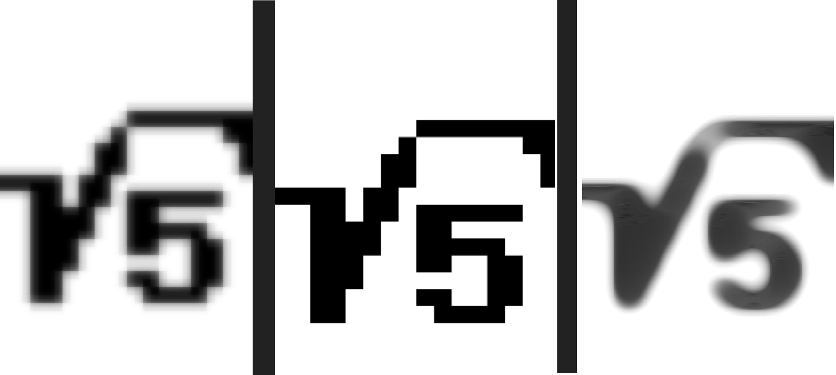
Results
Input Image
16 x 24 px.
Improving Image Resolution
(Edge Preservation) 1024 x 1536 px.
Improving Image Resolution and Readability 1024 x 1536 px.

Slide 17
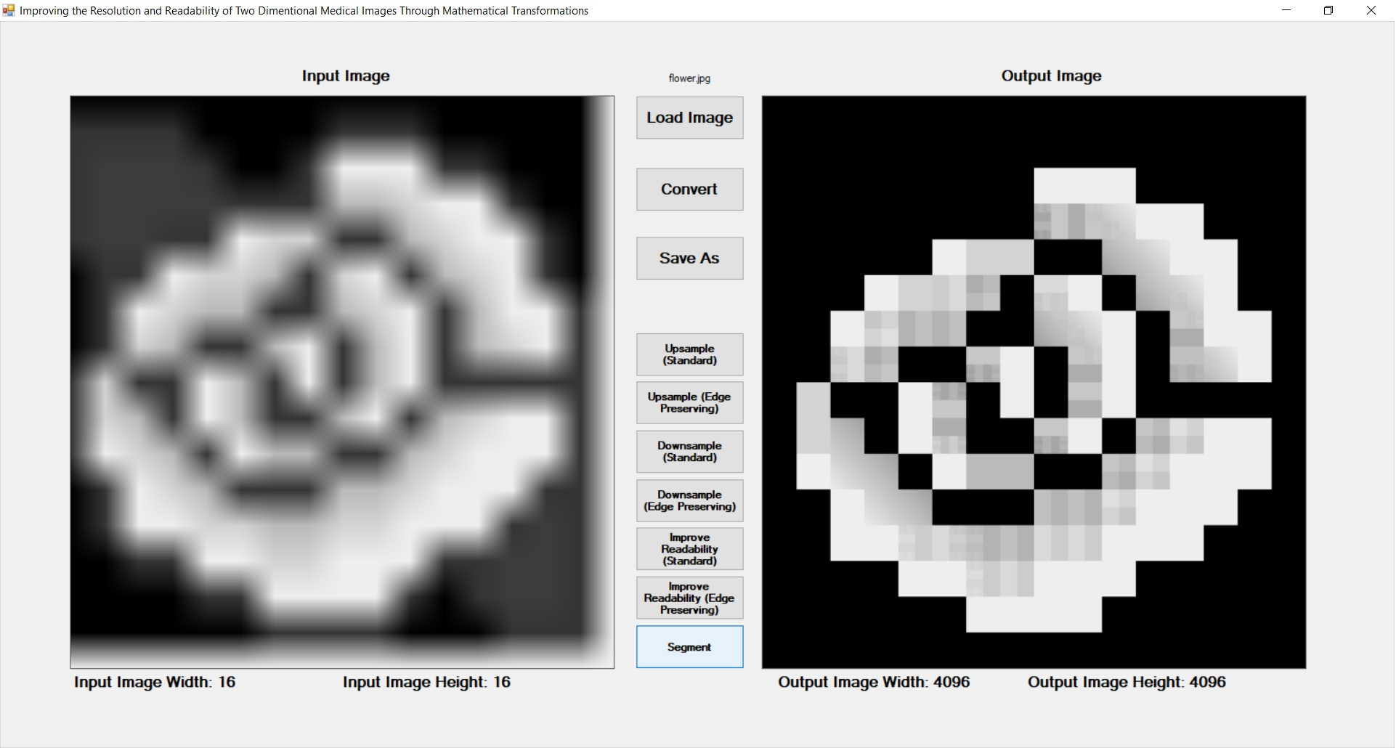

Slide 18
What is the contribution?
Created mathematical models for new algorithms
Mathematical modeling instead of neural networks
Novel Upsampling and Downsampling operators
Dynamical choice of the time step for the image readability
Comparison analysis between various image super-resolution techniques
Created desktop application
Created web application
It can save human lives by improving imaging diagnostics
It could be used against covid-19

Slide 19
Future Improvement
Implementing variable adjusting algorithm
Implementing neuron network
Automation
Anti-aliasing algorithm
Using more images (industrial and medical)

Slide 20
Acknowledgements
Assoc. Prof. Stanislav Harizanov (IMI-BAS)
Alexander Kolarski (senior programmer)
Assoc. Prof. Jenny Sendova (IMI-BAS)
Konstantin Delchev
Victor Kolev
“Young Talents” and Ministry of Education
HSSIMI & SRS19
Bulgarian Academy of Sciences
Institute of Mathematics and Informatics and Institute of Informational and Communicational Technologies
SAP & GeekyCamp (Stoyan Velev & Petar Ivanov)
Iliyan Cenkov & Dora Stoyanova (Informatics and Mathematics teachers)

Slide 21

Thank You for Your Attention

